Slide 1

Bitcoin Data Analysis
Group-3

Slide 2

What are we going to learn in this presentation?
Bitcoin adoption in the US through the lens of bitcoin ATM data
Some of the key features and their relationship with Bitcoin

Slide 3
Agenda
Intro and questions we tried to answer
Approach - Data sources, Financial Packages, Data Pre-processing
Solution and analysis findings:
Bitcoin adoption through ATM data analysis
Key observations and next steps
Bitcoin and SP500
Bitcoin and options volume
Bitcoin and Forex data
Bitcoin and wallet addresses, hash rates and difficulties
Correlation analysis between:
Bitcoin and CPI

Slide 4

Setting the context - Questions we tried to answer
How is the bitcoin adoption in the US?
What are some of trends and signals?
What’s the impact of China’s ban on Bitcoin mining?
How does the Bitcoin price move relative to the S&P 500 and other factors?
Does Bitcoin future volume show any relation to Bitcoin price movement?
Is there a correlation between Bitcoin price and Forex prices & CPI?
Is Bitcoin a good choice for portfolio diversification?

Slide 5
Our approach
Data Sources
Pandas
Data pre-processing
Postgres SQL
Important packages
CoinATM radar | Census.gov for Bitcoin ATM data and US population data
Deribit API for Bitcoin derivative data
Panel | Plotly | hvplot | matplotlib | seaborn
Quandl | MPL Finance
Notebook
Billion prices project site for CPI data
Concurrent Futures
nomics.com | Yahoo Finance API | Coingeko API | Quandl API for market data of Crypto and stocks
Quandl API for Bitcoin hashrate, difficulty and wallet addresses
Notes:
SQL for ATM data
Pandas: drop duplicates, fill na, etc
Asyncio (https://docs.python.org/3/library/asyncio.html): asyncio is a library to write concurrent code using the async/await syntax.
asyncio is used as a foundation for multiple Python asynchronous frameworks that provide high-performance network and web-servers, database connection libraries, distributed task queues, etc.
Concurrent Futures (https://docs.python.org/3/library/concurrent.futures.html): provides a high-level interface for asynchronously executing callables.
MPL Finance: makes it easier to create financial plots. It interfaces nicely with Pandas DataFrames.

Slide 6

Bitcoin Introduction

Slide 7
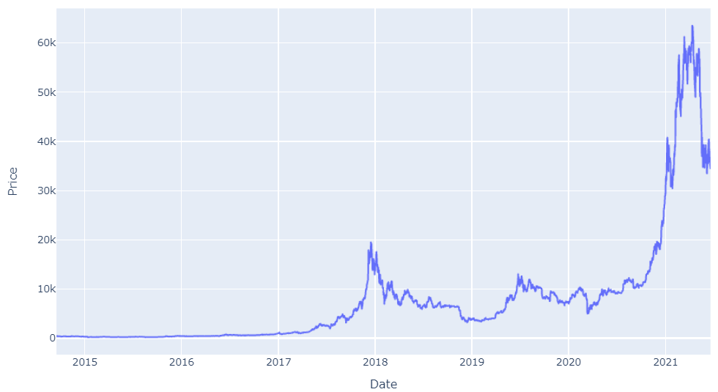
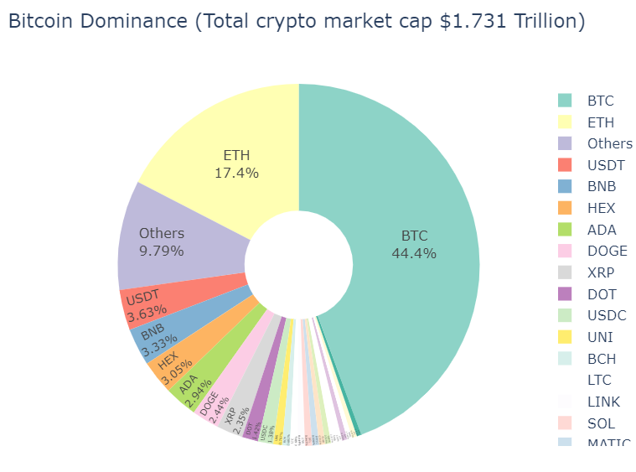
Bitcoin Market Dominance and Recent Price Action
~45% crypto market share Meteoric rise in price since it’s inception in 2009

Slide 8
How is the Bitcoin Adoption in the US?

Slide 9
Bitcoin adoption through ATM data analysis - Data Preparation in SQL
ATM_data_prep_script.sql

Slide 10
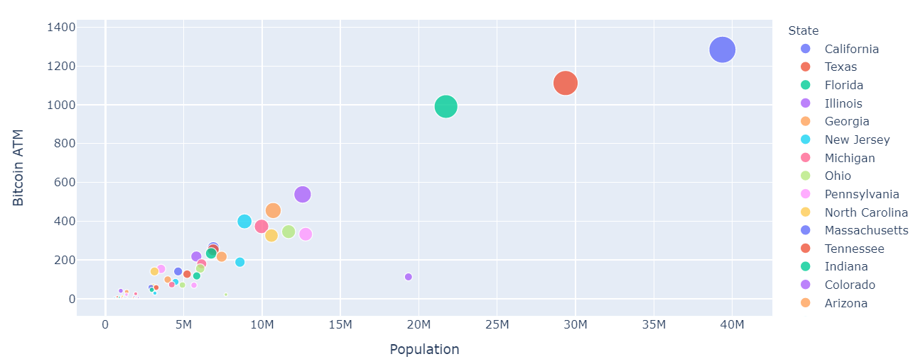
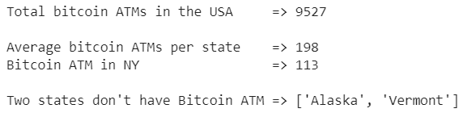
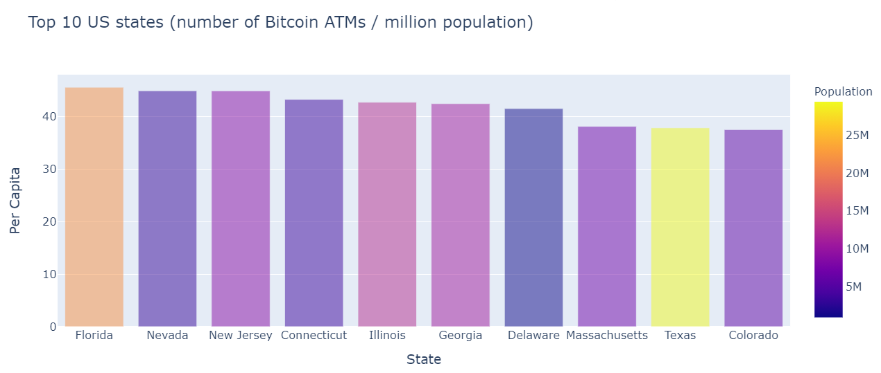
Bitcoin adoption – Bitcoin ATM Data Analysis
New York 4th most populous state with low adoption, Florida ahead of the pack. Alaska, Vermont yet to get their ATMs
Positive correlation
NY is exception
Florida “crypto currency capital”
Notes:
BitLicense legislation in 2015

Slide 11
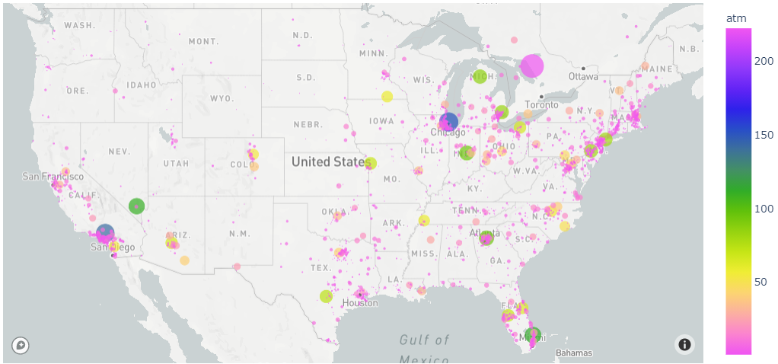
Bitcoin ATM Distribution in the US states
West coast needs some work to catch-up with East Coast and Central

Slide 12
How Volatile is Bitcoin?

Slide 13
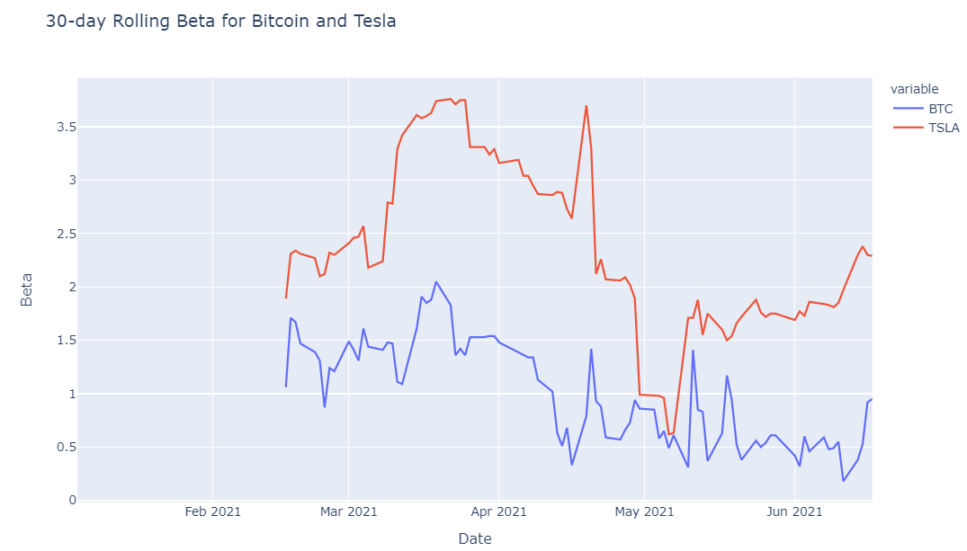
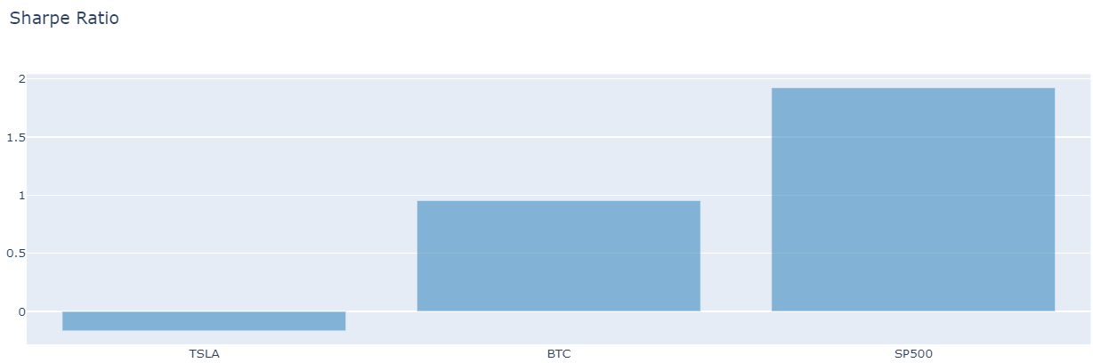
Bitcoin Volatility (Beta)
Bitcoin is volatile but Tesla is 119% more volatile than Bitcoin
Bitcoin beta : 1.12
Tesla beta : 2.46
Tesla 119% more volatile than Bitcoin
* Jan’2021 to June’2021 data

Slide 14
Can Bitcoin can be considered as a portfolio diversification vehicle?

Slide 15
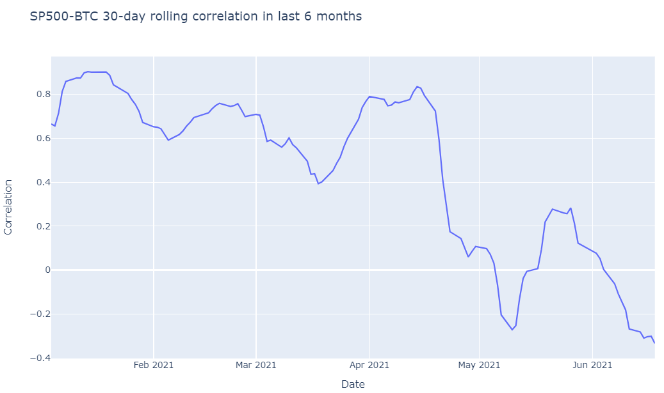
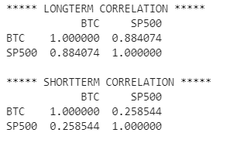
Bitcoin correlation with SP500
Bitcoin correlation with S&P500 is in downward trend – an emerging asset class for portfolio diversification
Bitcoin correlation with SP500 has been dipping in the past 6 months

Slide 16
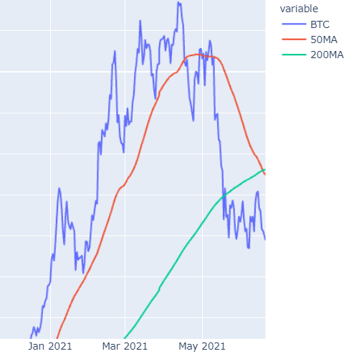
Why is the current bearish trend in Bitcoin price action when:
Adoption is increasing
Not the most volatile asset
Becoming less correlated with other asset classes
Death-cross

Slide 17
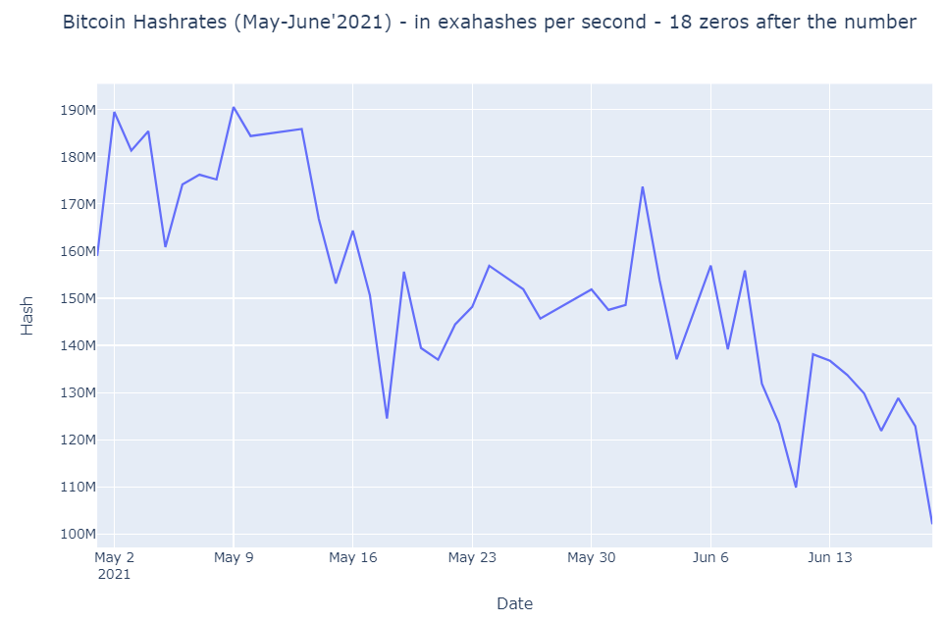
Environmental, Social, and Governance (ESG) Concerns
Bitcoin mining ban in one of the countries would propel Bitcoin mining to clean energy, would drastically reduce carbon footprint
173.68M
~35-40% of world’s mining capacity is expected to move to greener energy – paving the way to solve ESG concerns in next few months
More institutional adoption
102M

Slide 18
What are some of the features that can signal potential price movement?
Hash-rate, Difficulties and Wallet Addresses
Call/put volume
S&P500
Fiat
CPI

Slide 19
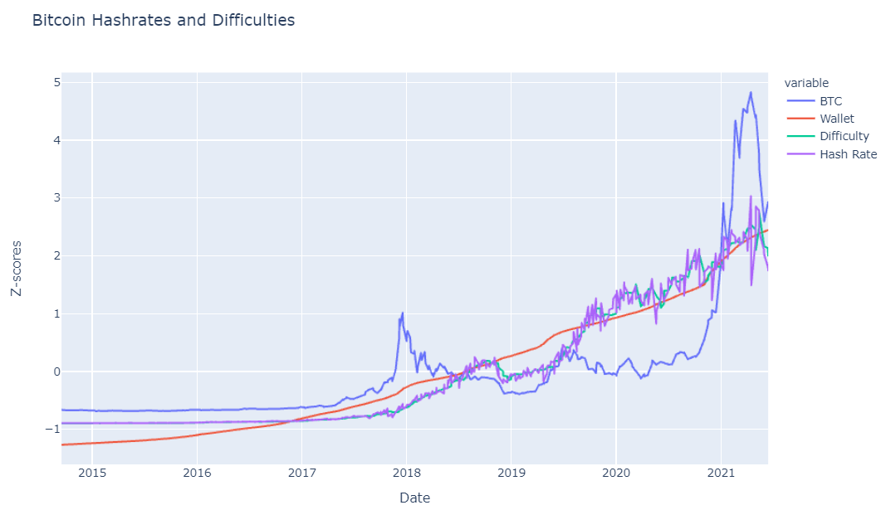
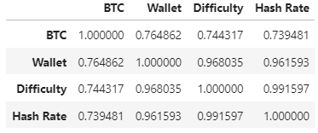
Correlation of Bitcoin price with Hash-rate, Difficulties and Wallet Addresses
All three features are strongly correlated with Bitcoin price movement

Slide 20
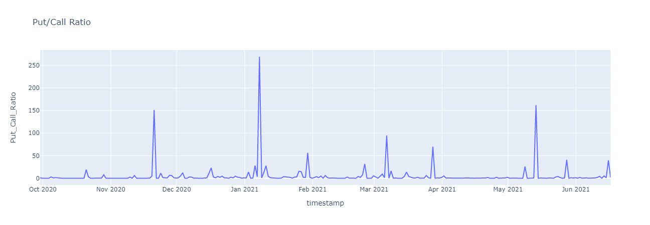
Bitcoin Options: Put/Call Ratio over time
Notes:
While diving into the bitcoin options market, we wanted to identify the P/C Ratio over time. Days with spikes are those where the transaction volume for Puts strongly exceeded the transaction volume for Calls, always in relative terms. We can identify these days as hedges or bearish moves.

Slide 21
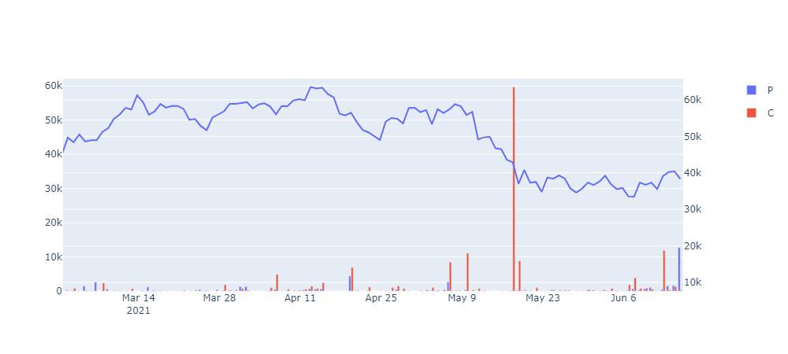
Bitcoin Options: Instrument Volume vs Price
Big volume (>10k) days observed changes in lower time frame trends shortly after
Notes:
We then decided to take a closer look to the actual volume of contracts traded per day and type while having the visual of the bitcoin price. We say significant volume before the breakdown at $43k mid May and also some interesting Call activity from $33k to $40k followed by Put activity on the rejection at 41k all the way down to $35k a couple days ago.

Slide 22
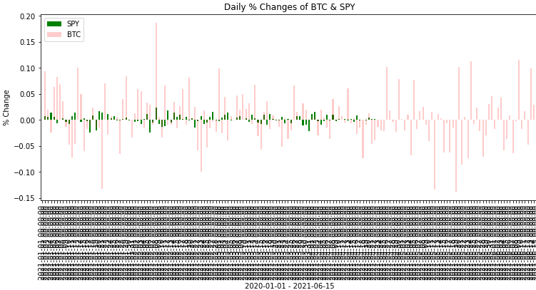
How does the Bitcoin Price move relative to the S&P 500?

Slide 23
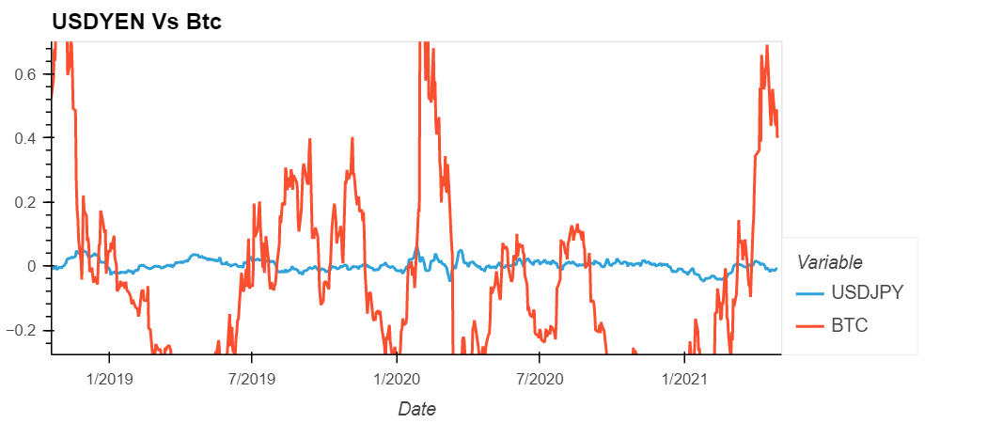
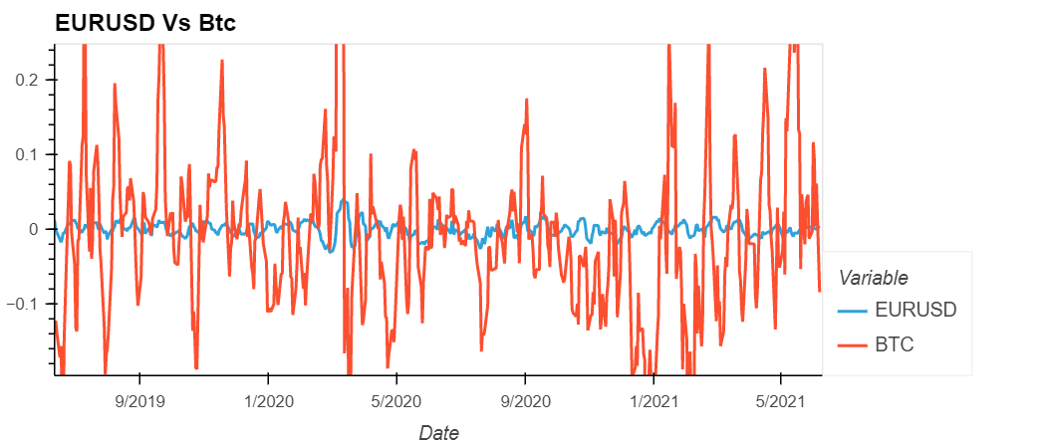
Fiat Vs Bitcoin

Slide 24
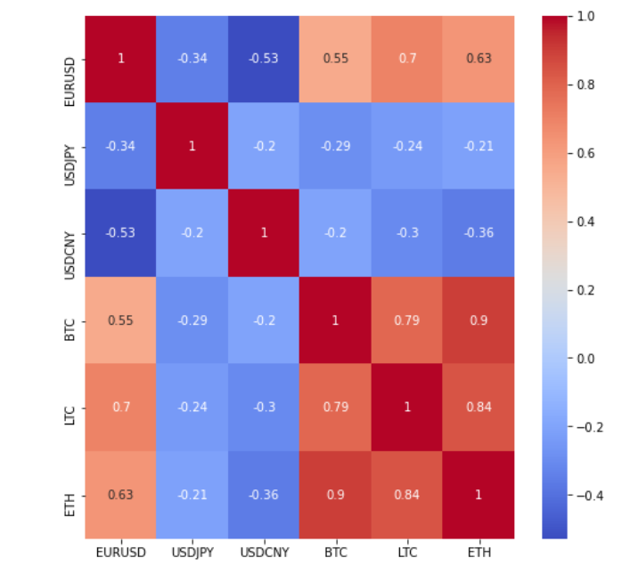
Top Fiat Currency Pairs and Crypto Correlations Heatmap

Slide 25
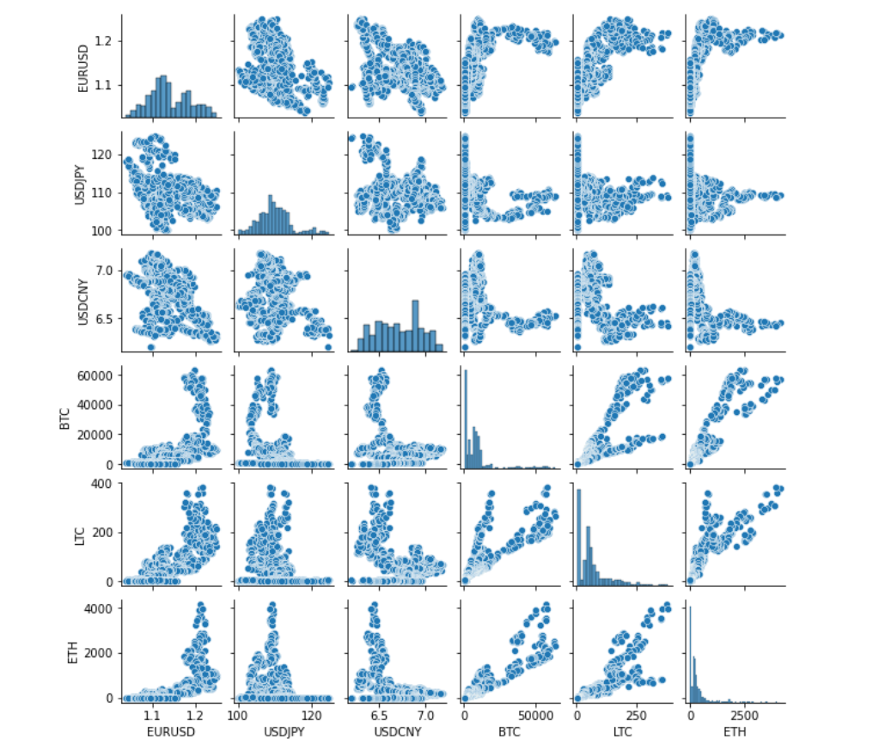
Correlation snapshot

Slide 26
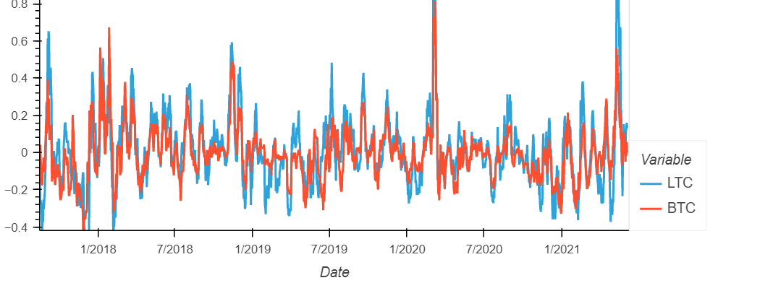

Slide 27
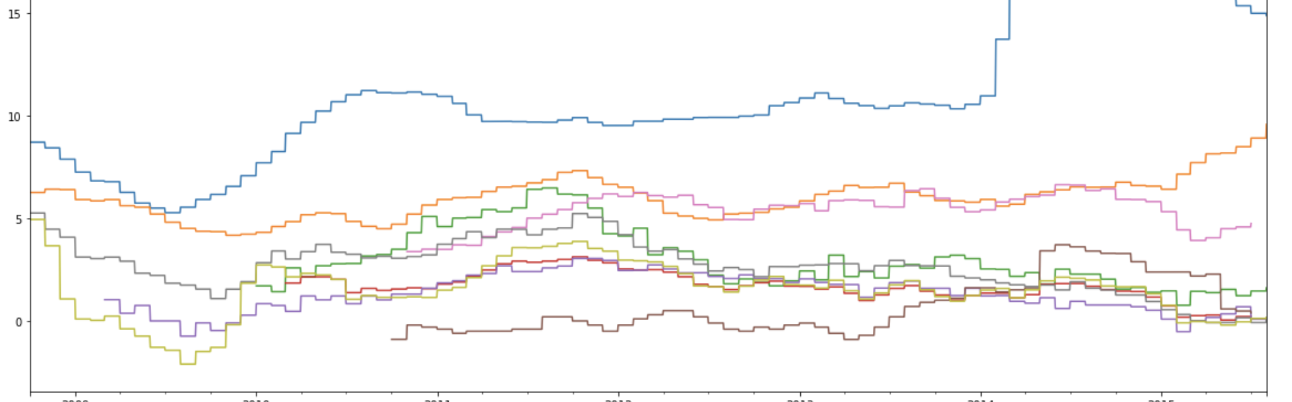
Consumer Price Index (9 Countries)

Slide 28
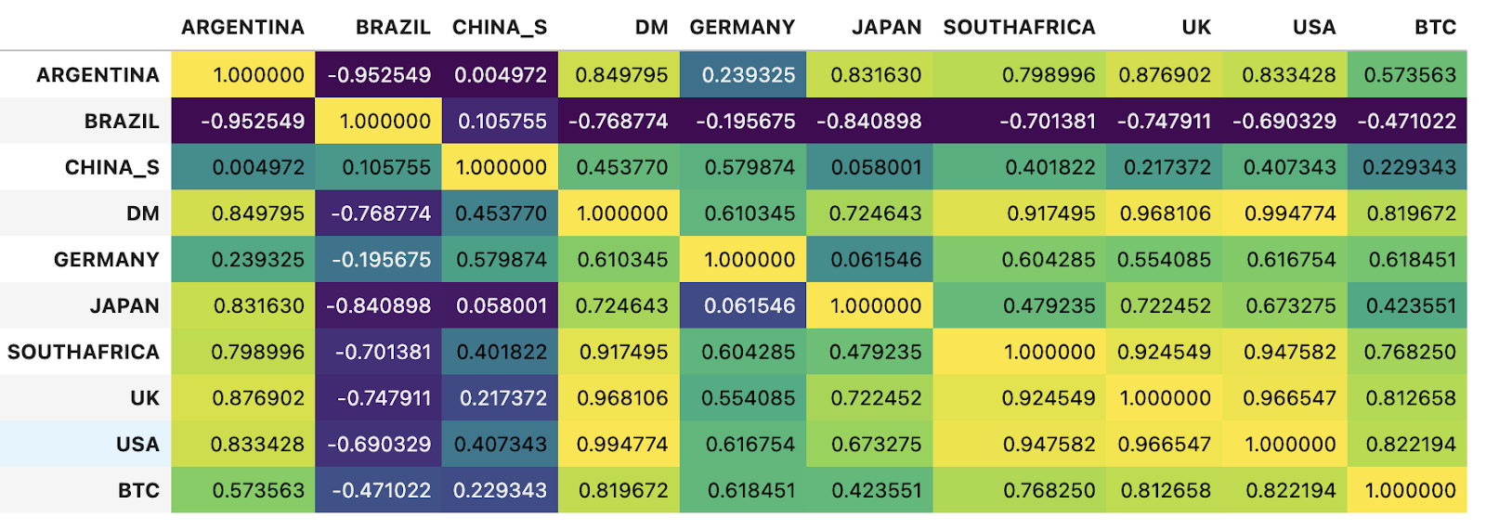
Consumer Price Index and Bitcoin Correlation

Slide 29
Key-observations
Fast adoption by both Ratail and Instituions
High risk – risk will be reduced as adoption gows
Bitcoin price action is strongly correlated with Hash-rate, difficulties and wallet addresses
Big options volume (>10K) days observed changes in lower time frame trends shortly after.
Correlation between Bitcoin price and Forex prices & CPI
Growing interest as an emerging asset class

Slide 30
Next Steps
Sentiment Analysis
Track big trade size on Blockchain
Descriptive to Predictive
Price movement forecasting based on time series data
On-chain Analysis
Emotions in textual communication through NLP
Data from Tweeter, Reddit, Bitcoin Talk
Identify market sentiment
Use market depth to gauge the impact
Look at strongly correlated assets
Refine the features used in project
Build and test models
Can be a leading market indicator
Create trigger
Evaluate opportunities for portfolio optimization reco

Slide 31

Sources
https://www.codearmo.com/python-tutorial/crypto-algo-trading-historical-data2
https://medium.com/cassandra-cryptoassets/introducing-python-websockets-and-asyncio-with-a-worked-example-37ff43f62935
https://github.com/schepal/deribit_data_collector

Slide 32

Thank You

